Slide 1
Powered by GPT - Software Quality Verification
System Under Test: Online Sales Management System
Course: Software Testing
Team:
Hoang Van Thien
Nguyen Thanh Dat
Le Quang Duy
Repository:
github.com/Alucard30Dec/Online-Sales-Management-System

Slide 2
Project And Test Scope
What We Tested
Admin UI
Public Product Catalog
Health API
Catalog API
Highest-Risk Business Areas
Authentication and permissions
Products and product import
Purchases
Invoices
Stock and reports

Slide 3
Test Strategy
Strategy
source-based project audit, not generic template testing
black-box execution + white-box-informed test design
manual testing for business logic and visible validation
targeted automation for high-value regression paths
Automation Stack
UI: .NET 8 + xUnit + Selenium
API: Postman + Newman
structure: Page Object Model + reusable helpers

Slide 4
Coverage And Team Allocation
Design Coverage
42 documented scenarios
63 total test cases
44 UI
19 API
100% scenario design coverage
Team Allocation
Hoang Van Thien: 17 UI cases
Nguyen Thanh Dat: 13 UI cases
Le Quang Duy: 14 UI cases

Slide 5
Automation Implementation
Implemented Automation Assets
Selenium UI project with Page Objects
shared config, wait helpers, screenshot capture
Postman collection with Newman runner
Priority Automated Flows
admin login smoke
sales permission check
purchase creation
invoice creation
product import preview
API health and catalog groups

Slide 6
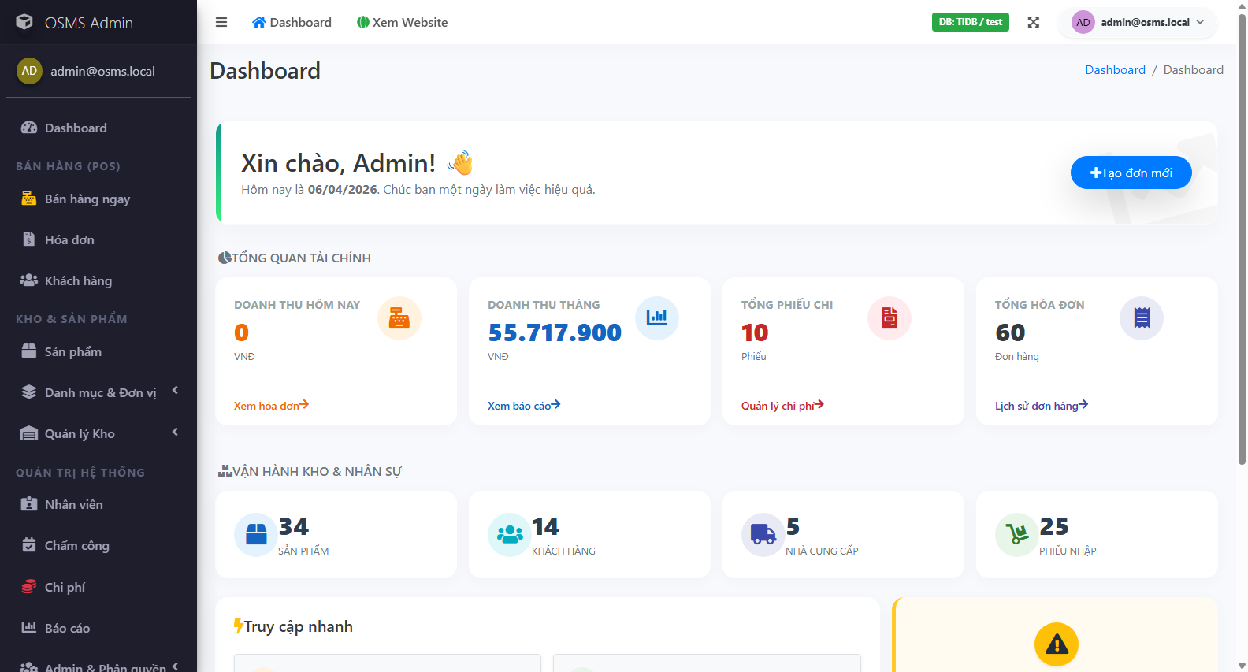
Real Execution Evidence
Confirmed Pass Evidence
TC-UI-AUTH-001 passed
TC-UI-AUTH-003 passed
TC-UI-IMP-002 passed
TC-UI-PUR-001 and TC-UI-PUR-007 passed
full API collection passed (19 / 19)
Confirmed Fail Evidence
TC-UI-INV-001 failed with UI and server-log proof
Important Rule
no unexecuted test was marked as pass
only one issue was promoted into a confirmed defect because the root cause was proven by server log evidence

Slide 7
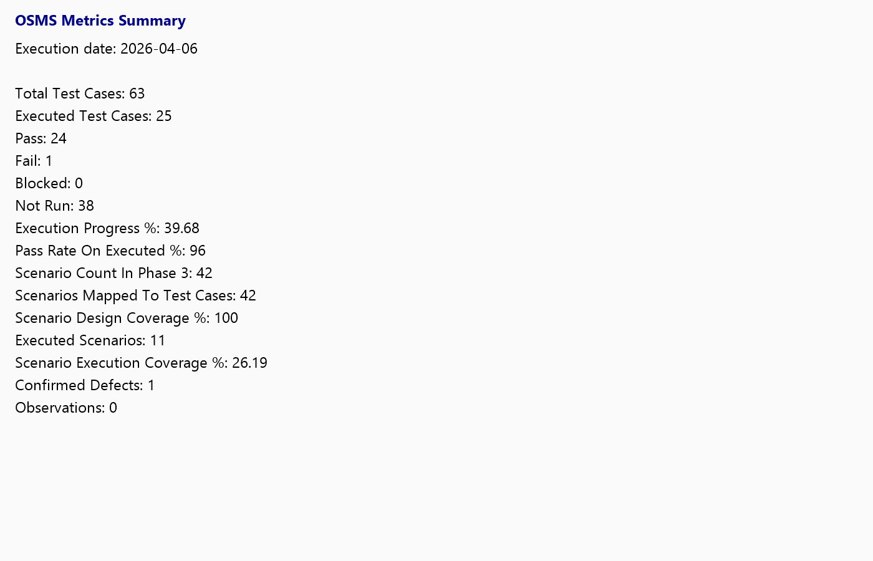
Current Metrics
Execution Summary As Of 2026-04-06
total cases: 63
executed: 25
pass: 24
fail: 1
blocked: 0
not run: 38
execution progress: 39.68%
Interface View
Admin UI: 6 executed, 5 pass, 1 fail
API: 19 executed, 19 pass

Slide 8
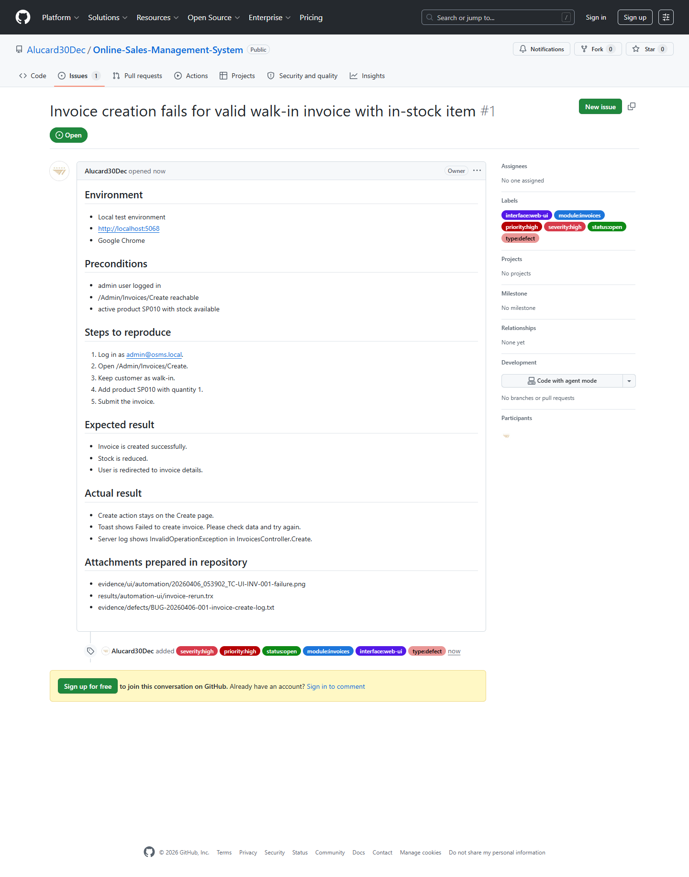
Defect And Risk Analysis
Confirmed Defects
1 confirmed defect
BUG-20260406-001 in invoice creation
tracked in GitHub Issue #1
Closed Observations
authorization redirect behavior
product import preview locator issue
Highest Business Risks Still Unverified
Stock
Products
Reports
Public Catalog UI

Slide 9
Key Insights
What We Can Defend
project is testable and automation-capable
source-based test design is strong
traceability from scenario -> test case -> result -> evidence -> defect is in place
What We Do Not Overclaim
current evidence still does not prove full system stability
one core business defect is currently confirmed
more UI execution is still required for high-confidence quality claims

Slide 10
Next Steps And Submission Package
Highest-Value Next Steps
1. fix and retest invoice creation through GitHub Issue #1
2. execute stock, reports, products, and public-catalog UI flows
3. add optional cross-browser evidence if Edge is available
4. refresh the report, slides, and metrics only if new execution evidence is added
Submission Package
Final report
PPTX
test cases
test data
automation scripts
final results
metrics
evidence
video

Slide 11
Q&A Backup
Likely Questions
Why do you have 0 confirmed defects?
Why is execution progress still low?
Why did you choose Selenium and Newman?
How do you distinguish automation failure from product defect?
Which module is riskiest right now?

